Slide 1
Ryan Pinto Director, Office of Juvenile Justice
Michael Pullmann Research Assistant Professor Public Behavioral Health and Justice Policy University of Washington
Rand Young WA State JDAI Coordinator

Slide 2
Efforts to reduce Racial & Ethnic Disparities in our Juvenile Justice System
Supreme Court Minority & Justice Commission
WA State Sentencing Commission
Center for Children & Youth Justice
WA Partnership Council on Juvenile Justice
U of W DMC Assessment
JDAI
DMC Reduction Plan
RED Committee
May 7th RED Symposium

Slide 3
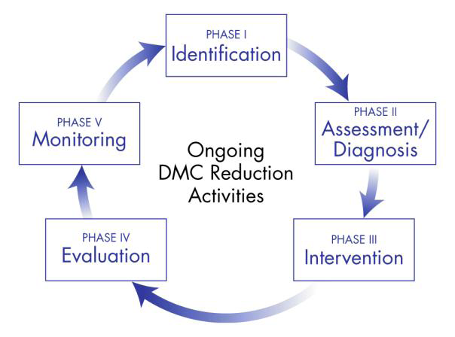
Notes:
This is the second part of a cycle of work that includes Identification of DMC, Assessment and Diagnosis, Intervention, Evaluation, and ongoing Monitoring.

Slide 4
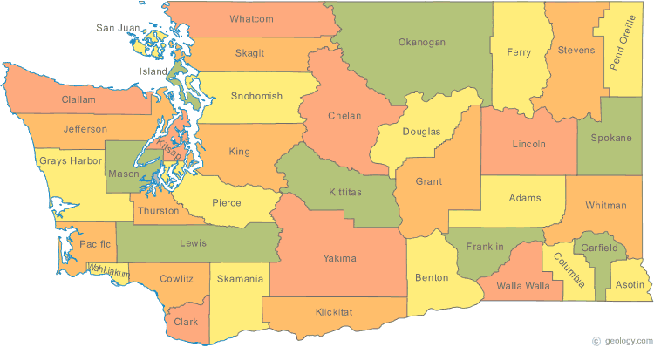
Washington State DMC Assessment
*
*
*
*
*
*
*
*
*
*
*
*
*
Two-part assessment:
1. Statistical analysis of disproportionality at several decision points
2. Qualitative in-depth interviews with 3-7 stakeholders in each jurisdiction
Notes:
This is the second part of a cycle of work that includes Identification of DMC, Assessment and Diagnosis, Intervention, Evaluation, and ongoing Monitoring.

Slide 5
Findings
Jurisdictions vary widely in sophistication about RED.
Data quality is poor in many jurisdictions
Cumulative disproportionality generally increases through the stages of justice system involvement for African Americans and Latinos.
Incremental disproportionality is highest at the front end of the system: arrest/referral, diversion, detention, and decision to petition.
Asian youth have consistently lower involvement with the justice system than white youth
Most interviewees believed that RED was the result of several interacting factors
Notes:
Highly localized & variable from jurisdiction to jurisdiction
Awareness of DMC
“Ownership” of DMC
Explanations for DMC
Approaches to addressing DMC
Deep concern within many court administrations that disproportionality has remained steady while overall court contacts have dropped
“Loose coupling” of the juvenile justice system is cited as barrier to addressing DMC
Risk factors correlated with offending:
poverty and socio-economic factors,
institutionalized racism,
conscious or unconscious bias,
policies and procedures,
access to services and supports,
migration,
gangs,
“school-to-prison pipeline”,
cultural differences,
racial/ethnic differences in offense history,
adverse childhood experiences,
and many more.

Slide 6
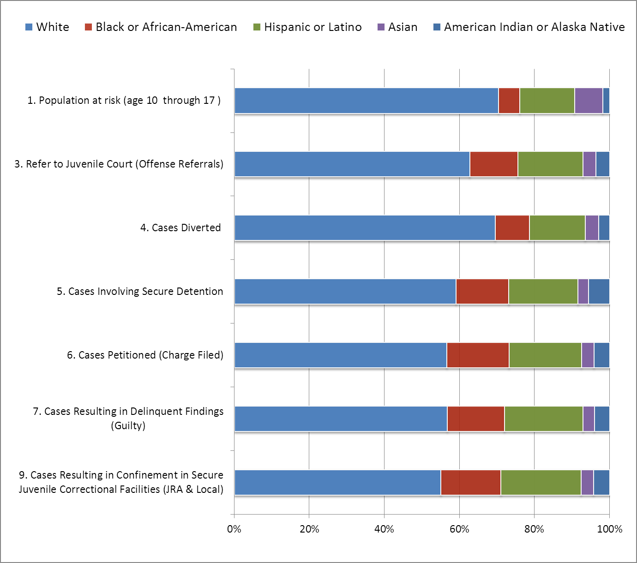
Washington State (2009)

Slide 7
There are promising RED reduction efforts across the state
JJ & RA
Data quality trainings
Multidisciplinary RED reduction committees
Reminder systems to prevent warrants for failure to appear
Collaboration with tribal court and authorities
Increasing alternatives to detention
Notes:
JJ & RA SWOT analysis, investigation of possible contributors to RED, diversity training, and disaggregation of data by race/ethnicity

Slide 8
Recommendations
Build an infrastructure to address RED at local and state levels
Coordination and leadership
Assess and modify policy and practice
Improved knowledge of DMC
Notes:
Improve data collection
Law enforcement
Local Juvenile Courts
Juvenile Rehabilitation Administration
Review policies and procedures for collecting Latino ethnicity
Consider expanding categories to include country of origin
Trainings on RED, institutional racism, and culturally-based differences in communication
Implement and sustain changes to policies, practices, and procedures. Examples:
Cultural and linguistically competent diversion practices
Warrant prevention
Standardized detention risk assessments
Parole
Increase the enrollment, retention, and completing rates of youth of color in evidence-based behavioral health programs
Access
Relevance
Effectiveness
Base RED reduction approaches on local data, experiences, and stakeholder involvement
Strengthen and coordinate statewide leadership on RED reduction
Work to increase buy-in and ownership across all stakeholder groups within jurisdictions
Cross-system coalitions to address RED
Involve communities of color in justice system decision making
Collaborate with tribal authorities, tribal law enforcement, and tribal courts

Slide 9
May 7th Racial & Ethnic Disparities Symposium
Purpose of Symposium: provide information/resources to assist county juvenile courts in implementing the University of Washington DMC Assessment recommendations.
70 Participants: 5-person teams from 12 juvenile courts, JJ & RA, WA-PCJJ
Faculty: Burns Institute – James Bell & Laura John Ridolfe
Symposium Agenda:
Overview of racial & ethnic disparities in the juvenile justice system
Using data to identify/measure REDs at JJS decision points
Questions for Teams:
Has your jurisdiction used data to identify racial & ethnic disparities?
Does your jurisdiction have political will and leadership to reduce REDs?
Is there a RED committee with JJS and community representation?
Action Plan identifying the top 2 ideas or strategies jurisdictions will implement
WA-PCJJ Funding: for additional training & technical assistance to assist jurisdictions in implementing their action plans.

